Slide 1
Human-in-The-Loop and Graph theoretic aspects of a Smart Control Room Sambit Ghosh Advisor: Prof. B. Wayne Bequette
Department of Chemical and Biological Eng.| 7/7/2021

Slide 2
Content
Introduction
Part 1: Smart Control Room overview
Part 2: Vinyl Acetate Monomer flowsheet and distillation column startup
Part 3: Human-in-The-Loop Supervisory Model Predictive Control
Part 4: Graph Signal Processing
Part 5: Plant startup experiment design
Overall summary
Future directions
Acknowledgements

Slide 3
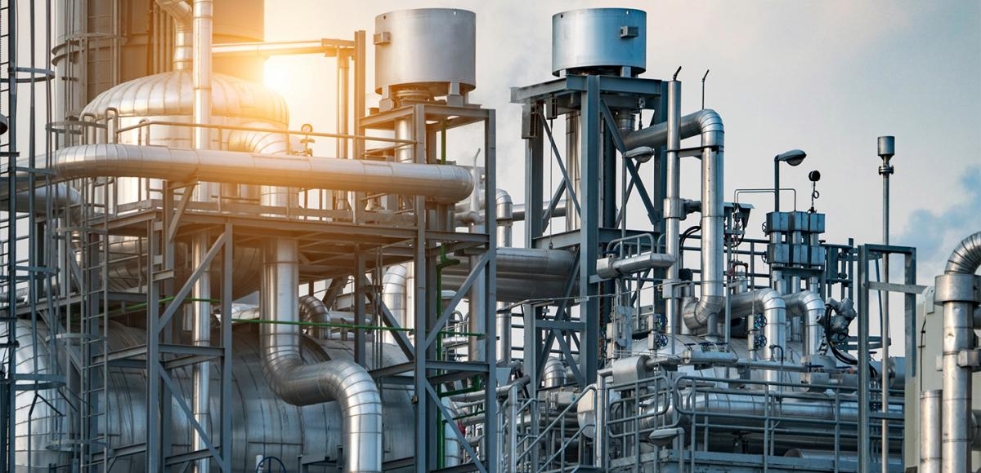
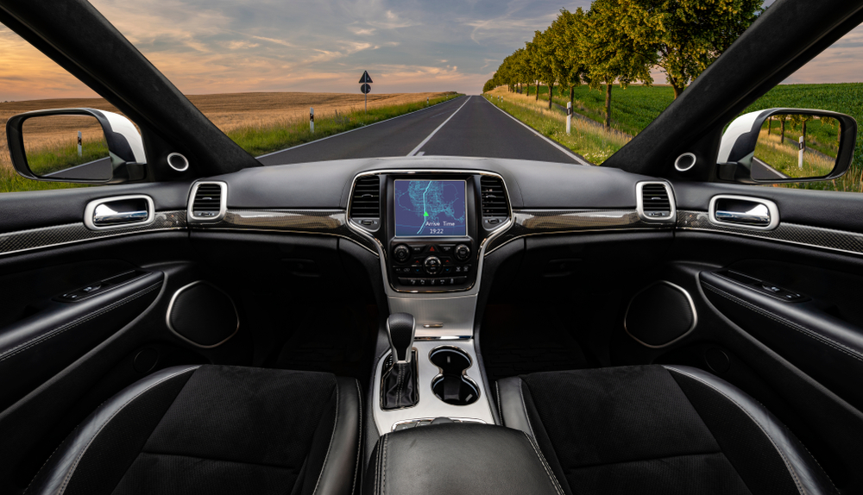
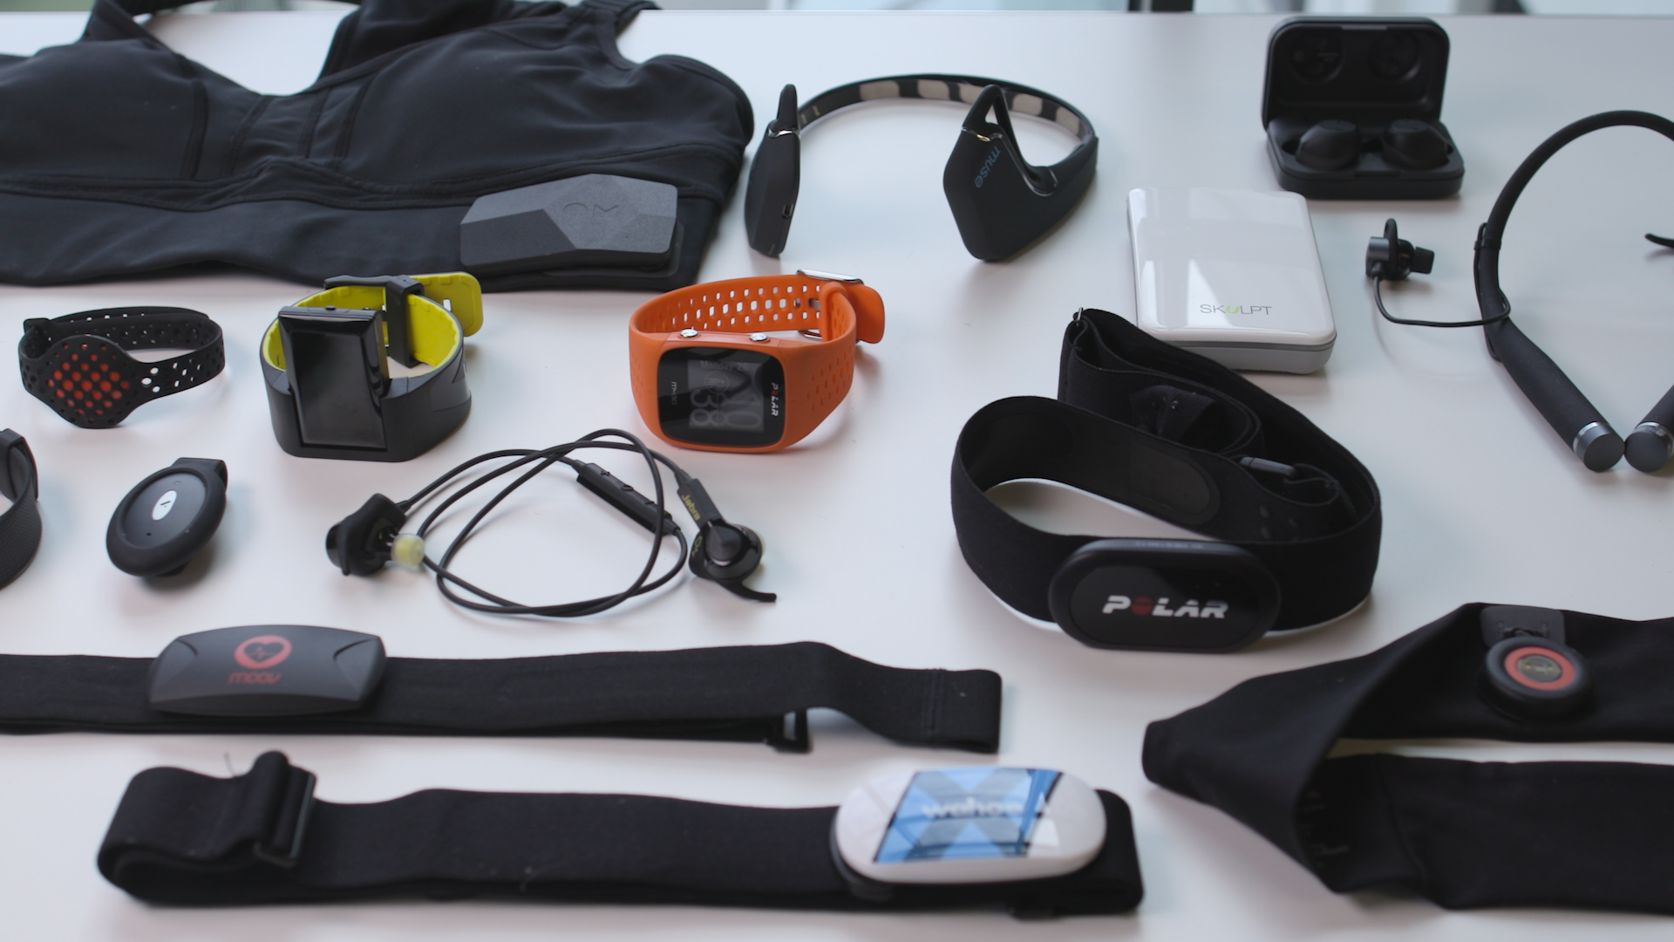
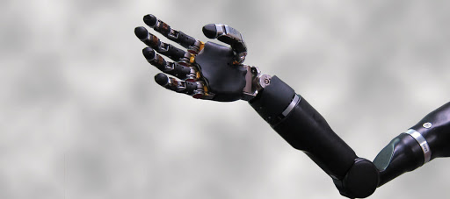
Introduction
Human factors all around
Human-in-the-loop and Human-out-of-loop effects
Human interaction with automation

Slide 4
Introduction

Slide 5



Human-in-The-Loop (HiTL) and Network view
Reactor
Reactor
Ghosh, S. and Bequette, B.W., 2019. Process Systems Engineering and the Human-in-The-Loop: The Smart Control Room. Industrial & Engineering Chemistry Research, 59(6), pp.2422-2429.
Part 1

Slide 6
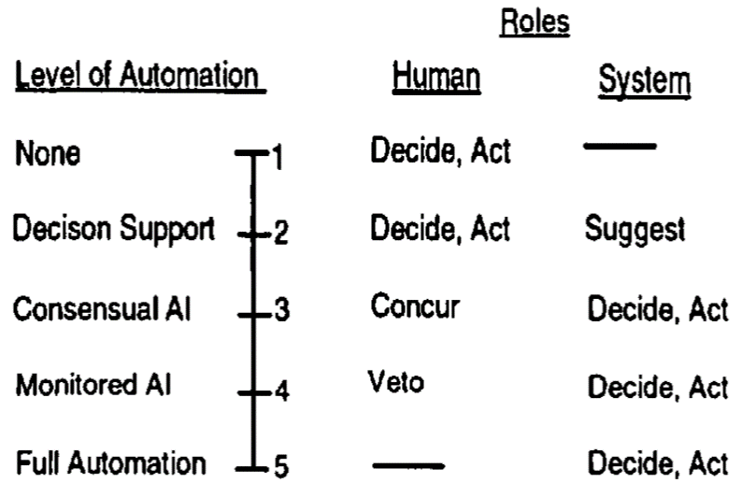
HiTL aspects
Background
Automation increases operator workload – Bainbridge (1983)
Decision arise from experience, knowledge, goals & process demands – Rasmussen (1983)
Other industries
Most HiTL seen in automated vehicles, robotics and aeronautics
Process industries
Lack HiTL technologies
Data representation key for HiTL – Nunes et al. (2015)
Endsley, M.R. and Kiris, E.O., 1995. The out-of-the-loop performance problem and level of control in automation. Human factors, 37(2), pp.381-394.
Part 1

Slide 7
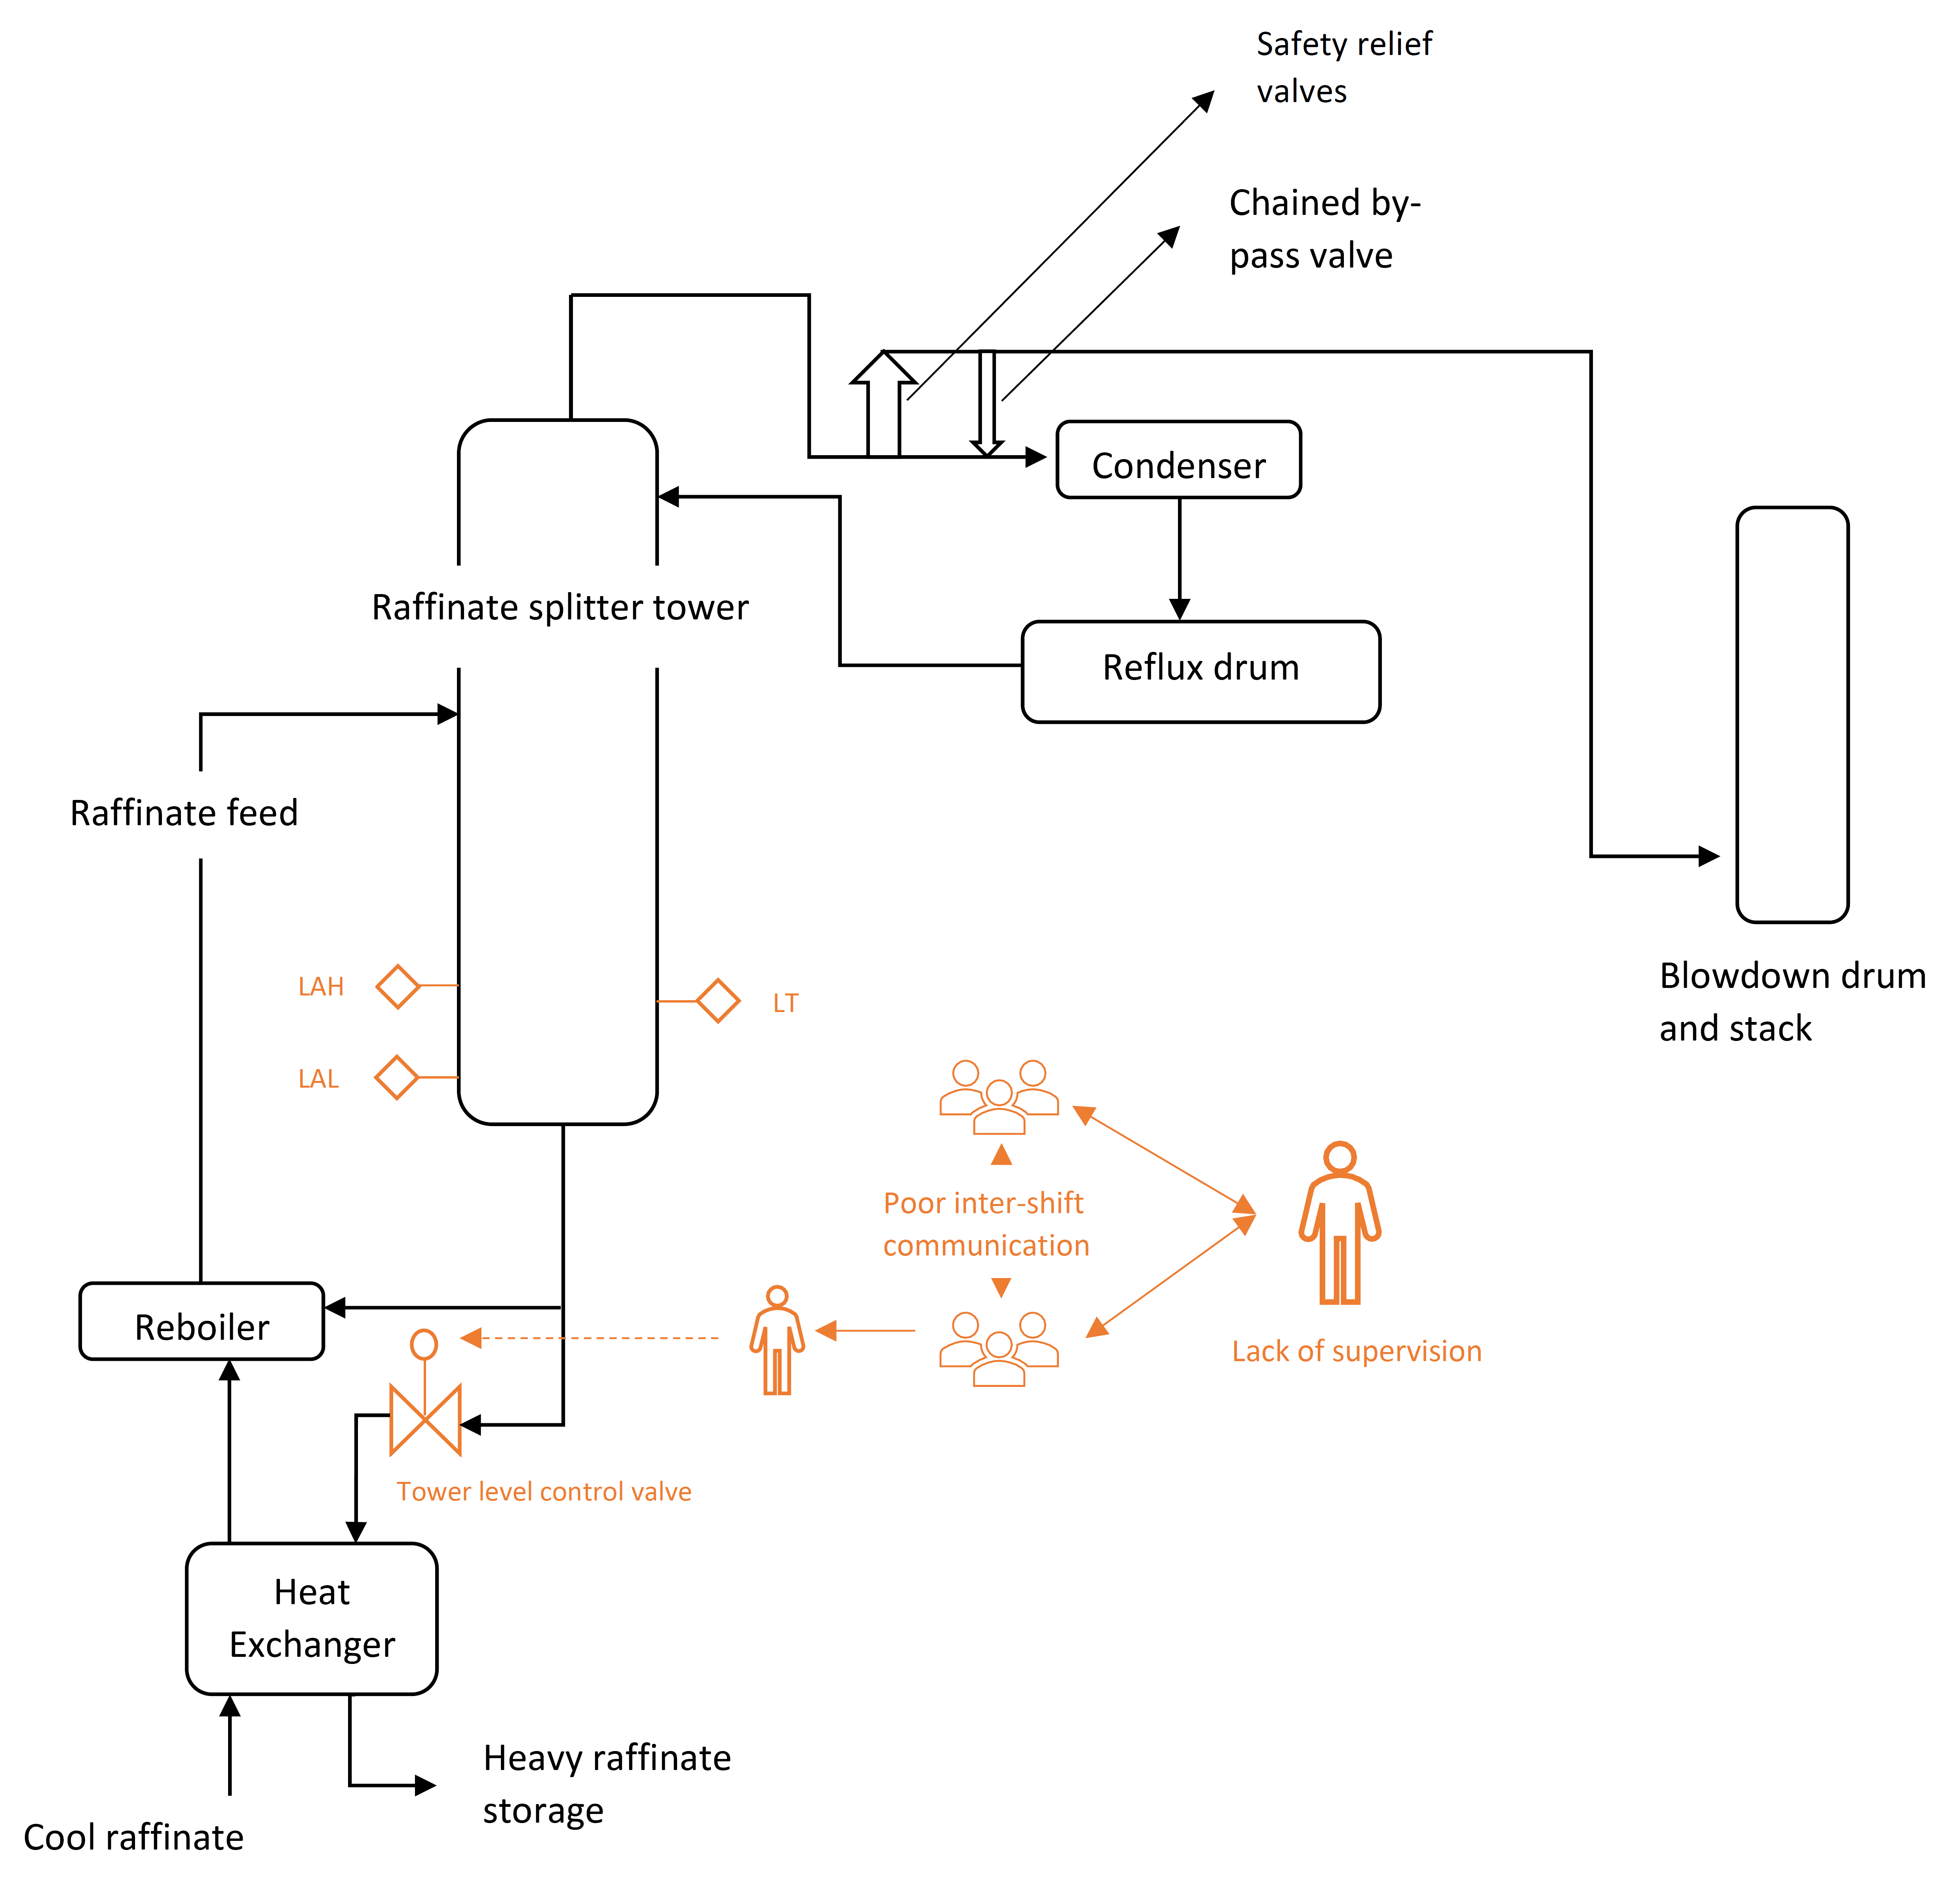
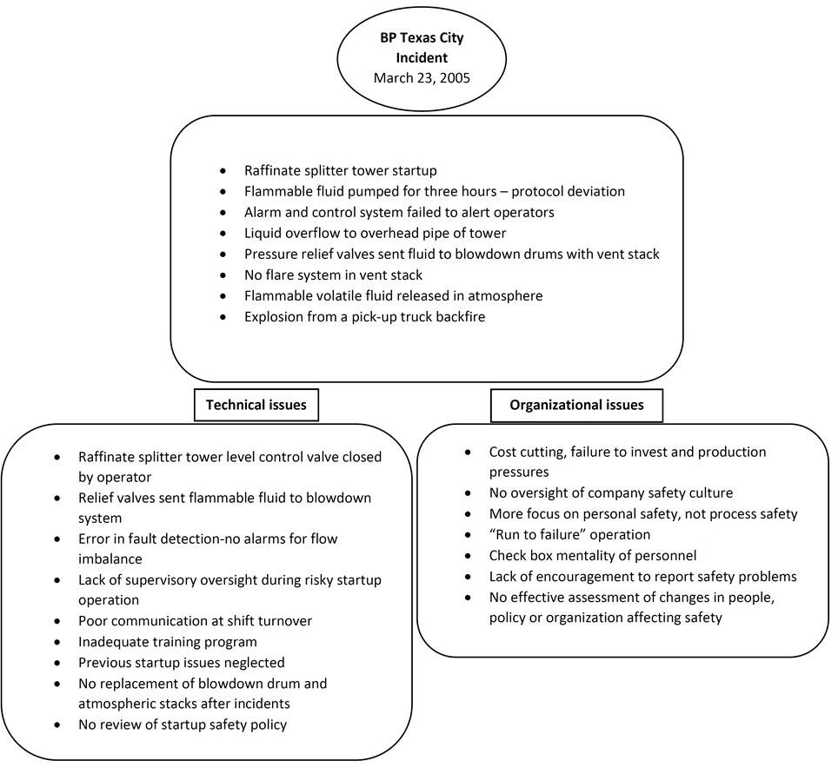
BP Texas City case study
Ghosh, S. and Bequette, B.W., 2019. Process Systems Engineering and the Human-in-The-Loop: The Smart Control Room. Industrial & Engineering Chemistry Research, 59(6), pp.2422-2429.
Part 1

Slide 8
Smart Control Room
Test process simulation
HiTL Supervisory
MPC
Research parts
Graph-theoretic analysis
Startup human experiments
Ghosh, S. and Bequette, B.W., 2019. Process Systems Engineering and the Human-in-The-Loop: The Smart Control Room. Industrial & Engineering Chemistry Research, 59(6), pp.2422-2429.
Part 1

Slide 9
Summary
HiTL and Network view of process systems
Key factors affecting HiTL
Motivating case study
Smart Control Room framework
Part 1

Slide 10
Vinyl Acetate Monomer (VAM) process
Overview
C₂H₄ + CH₃COOH + ½ O₂ →CH₂=CHOCOCH₃ + H₂O
Aspen Dynamics
Initial development in Aspen Plus for steady-state
MATLAB
Nonlinear codes replicating Aspen flowsheet
Main mismatches
C₂H₄ + 3O₂ → 2CO₂ + 2H₂O
Absorber (rate-based) in MATLAB vs (equilibrium) Aspen
Main reaction:
Side reaction:
Vinyl acetate is an industrial polymer used in making glues, paints, textiles etc.
Transported to Aspen Dynamics
25 single input single output (SISO) control loops
Main control objectives:
1. Reactor feed O2 concentration
2. Reactor peak temperature
3. Column product concentration
Individual unit-ops as scripts
Combined in a script as FullPlant
MasterScript runs the simulation using calculated PI outputs for 1 sample time
Necessary modifications in distillation model
Tray hydraulic differences in Absorber and Column
Leads to overall differences in concentrations and flowrates
Numerous step-tests performed to test stability of both flowsheets
Luyben, M.L., Tyréus, B.D., 1998. An industrial design/control study for the vinyl acetate monomer process. Comput. Chem. Eng. 22, 867–877. https://doi.org/10.1016/S0098-1354(98)00030-1
Chen, R., McAvoy, T., Dave, K., Luyben, M., 2003a. A Nonlinear Dynamic Model of a Vinyl Acetate Process 1–28. https://doi.org/10.1021/ie020859k
Part 2

Slide 11
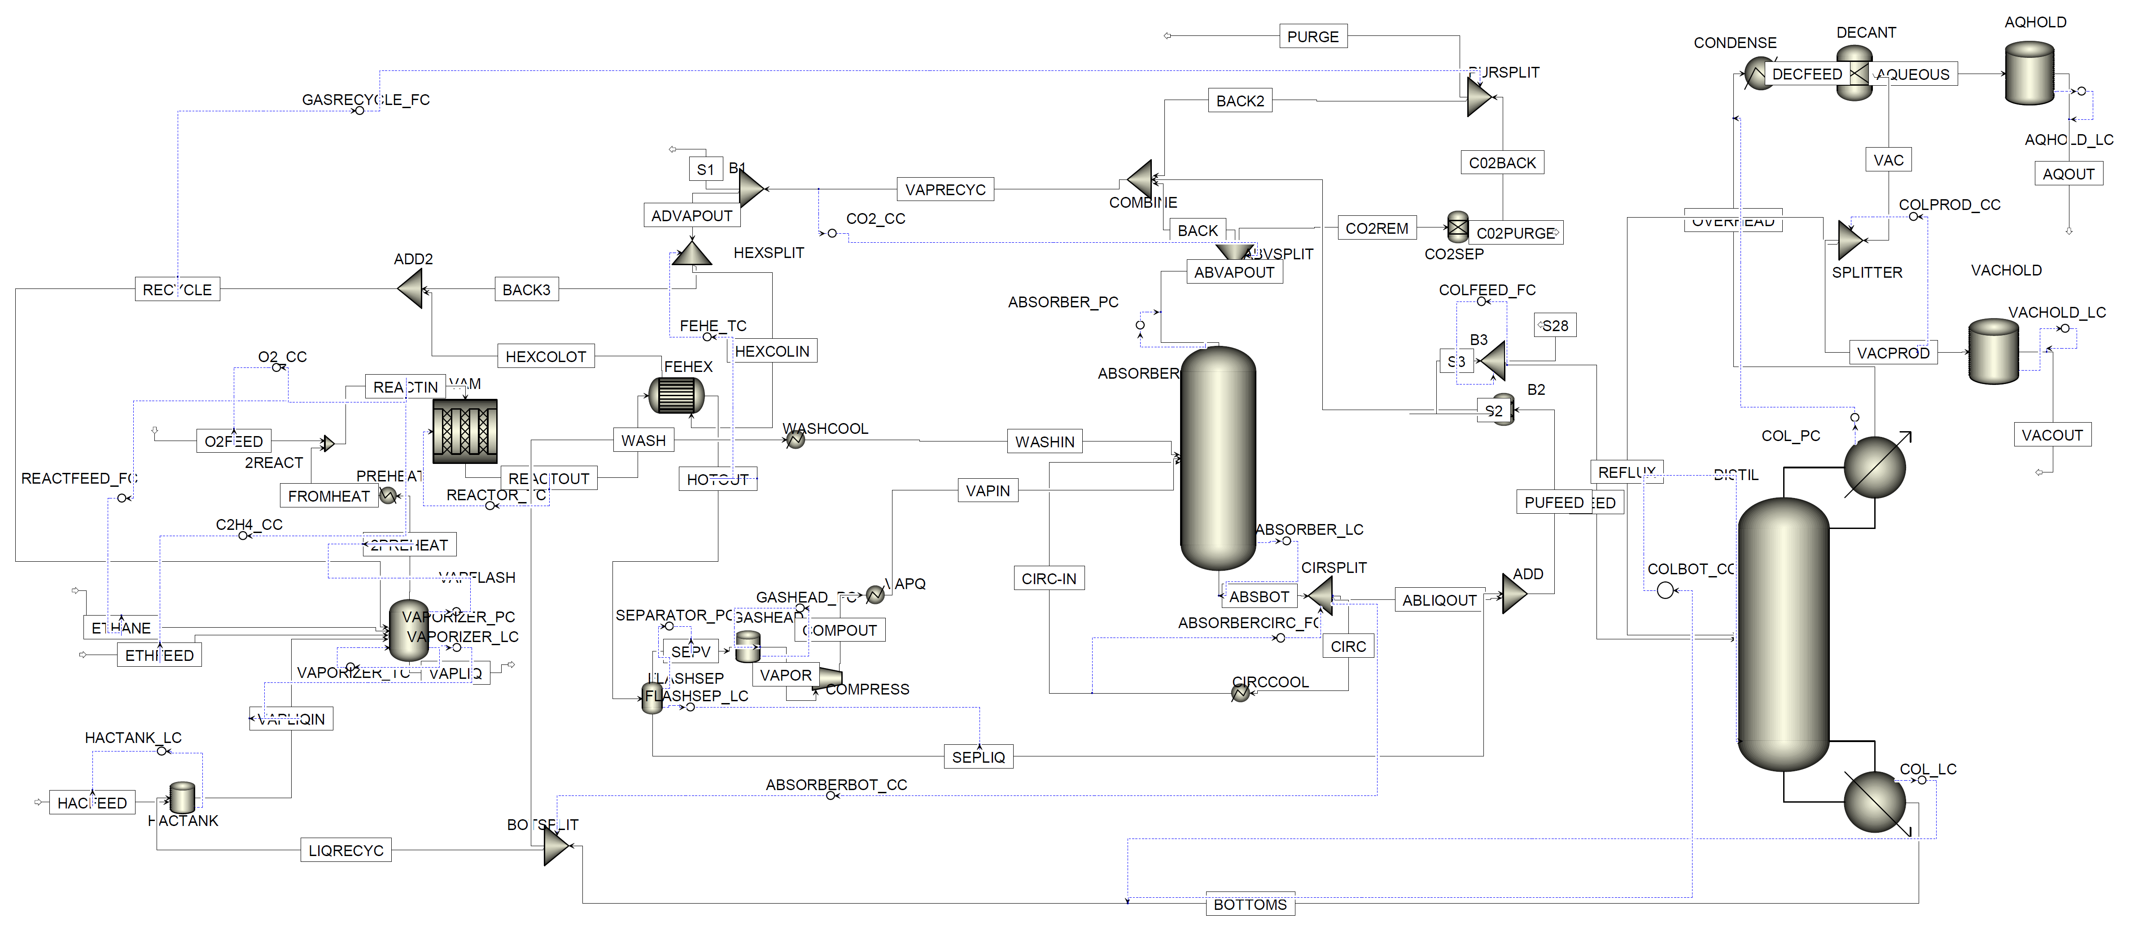
VAM Flowsheet
Part 2

Slide 12
VAM Step tests
ColProd CC step change
React TC step change
Part 2

Slide 13
VAM Step tests
C2H4 CC step change
AbsBot CC step change
Part 2

Slide 14
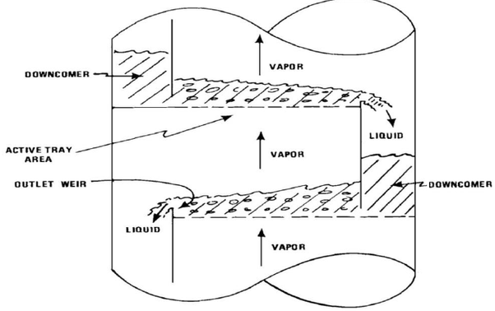
Distillation startup
1
Modify equations to reduce DAE index
2
Switching law: use bubble point Pressure
3
Fix startup input profiles → Feed, Reboiler duty, Reflux
Dynamically switch equation set
Rackett equation for liquid density
Peng-Robinson method for vapor density
Two sets: non-VLE and VLE
Initial manual inputs → close PI loop
Part 2

Slide 15
Startup simulation
Input profiles for Feed, Reboiler duty and Reflux ratio
Liquid flow rates from trays. Feed trays and tray below fill up first. Top trays fill up after Reflux is started
Part 2

Slide 16
Startup simulation
Vapor starts to form when reboiler sump liquid reaches VLE and all trays switch from non-VLE to VLE in sequence
Tray temperature profiles show initial numerical jumps
Part 2

Slide 17
Startup simulation
Non-VEL to VLE switching using Bubble point pressure
Density differences due to ideal and non-ideal assumptions
Part 2

Slide 18
Summary
Plantwide flowsheet for SCR use
Aspen Dynamics and MATLAB implementation
Modifications for distillation column startup and simulation results
Part 2

Slide 19
Part 3 – Human and Automation
Human automation interaction dynamics
Operator task, complexity, in versus out of loop
Operator trust in automation
Cognitive science aspects – expertise, decision making, cognitive load
How are other disciplines handling these?
Ideas from semi-autonomous vehicles, robotic and aeronautics
Shared control paradigms
Storms, J.G., Tilbury, D.M., 2014. Blending of human and obstacle avoidance control for a high speed mobile robot. Proc. Am. Control Conf. 3488–3493. https://doi.org/10.1109/ACC.2014.6859352
Rasmussen, J., 1983. Skills, rules and knowledge ; Signals, signs and symbols and other distinctions in human performance models. IEEE Trans. Syst. Man. Cybern. 13, 257–266.
Chipalkatty, R., Daepp, H., Egerstedt, M., Book, W., 2011. Human-in-the-loop: MPC for shared control of a quadruped rescue robot. 2011 IEEE/RSJ Int. Conf. Intell. Robot. Syst. 4556–4561. https://doi.org/10.1109/iros.2011.6094601
Part 3

Slide 20
Model Predictive Control (MPC)
Developed by Shell and Cutler and Ramaker (1980), Richalet et.al (1976), Clarke et.al (1987a and 1987 b)
Advanced control using plant model and optimization
M Optimal control moves
Implement 1st move
States
Update and repeat
Predict P time steps
B. Wayne Bequette. Process Control-Modeling, Design and Simulation. Prentice-Hall, Inc., Upper Saddle River, NJ, 2003.
Part 3

Slide 21
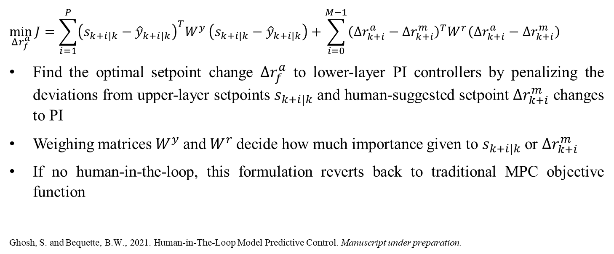
MPC Formulation
$$\min_{Δr_{f}^{a}}{J=\sum_{i=1}^{P}{{\left(s_{k+i|k}−{\hat{y}}_{k+i|k}\right)}^{T}W^{y}}}\left(s_{k+i|k}−{\hat{y}}_{k+i|k}\right)+\sum_{i=0}^{M−1}{{\left(Δr_{k+i}^{a}−Δr_{k+i}^{m}\right)}^{T}W^{r}\left(Δr_{k+i}^{a}−Δr_{k+i}^{m}\right)}$$
Find the optimal setpoint change $Δr_{f}^{a}$ to lower-layer PI controllers by penalizing the deviations from upper-layer setpoints $s_{k+i|k}$ and human-suggested setpoint $Δr_{k+i}^{m}$ changes to PI
Weighing matrices $W^{y}$and $W^{r}$decide how much importance given to $s_{k+i|k}$ or $Δr_{k+i}^{m}$
If no human-in-the-loop, this formulation reverts back to traditional MPC objective function
Ghosh, S. and Bequette, B.W., 2021. Human-in-The-Loop Model Predictive Control. Manuscript under preparation.
Part 3

Slide 22
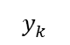
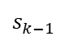
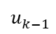
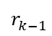
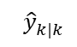
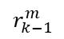
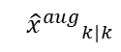
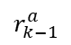
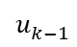
Block Diagram
MPC Model
Human
$$r_{k−1}^{a}$$
C
O
M
B
I
N
E
$$s_{k−1}$$
$$r_{k−1}^{ }$$
$$u_{k−1}^{ }$$
Plant
$$y_{k}^{ }$$
PID
$$r_{k−1}^{m}$$
Upper layer setpoints
MPC
$$^{ }{{\hat{x}}^{aug}}_{k|k}^{ }$$
$$^{ }{\hat{y}}_{k|k}^{ }$$
$$u_{k−1}^{ }$$
State Estimation
$$y_{k}^{ }$$
Part 3

Slide 23
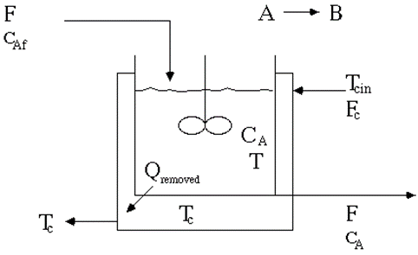
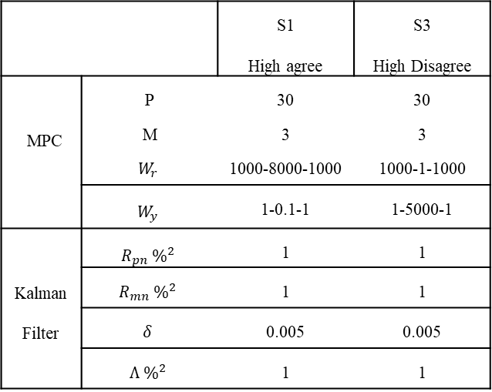
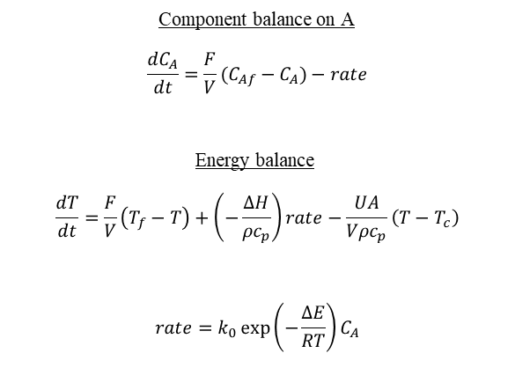
Single Input Single Output (SISO) Example
 |  | S1 High agree | S3 High Disagree
MPC | P | 30 | 30
 | M | 3 | 3
 | $$W_{r}$$ | 1000-8000-1000 | 1000-1-1000
 | $$W_{y}$$ | 1-0.1-1 | 1-5000-1
Kalman Filter | $R_{pn} \%^{2}$ | 1 | 1
 | $$R_{mn} \%^{2}$$ | 1 | 1
 | $$δ$$ | 0.005 | 0.005
 | $$Λ \%^{2}$$ | 1 | 1
Component balance on A
$$\frac{dC_{A}}{dt}=\frac{F}{V}(C_{Af}−C_{A})−rate$$
Energy balance
$$\frac{dT}{dt}=\frac{F}{V}\left(T_{f}−T\right)+\left(−\frac{ΔH}{ρc_{p}}\right)rate−\frac{UA}{Vρc_{p}}\left(T−T_{c}\right)$$
$$rate=k_{0}\exp\left(−\frac{ΔE}{RT}\right)C_{A}$$
Part 3

Slide 24
SISO Results
MPC-Human high agreement
MPC-Human high disagreement
Part 3

Slide 25
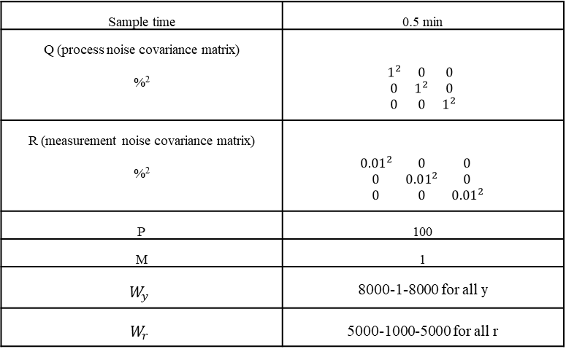
Multi Input Multi Output (MIMO) Example
Sample time | 0.5 min
Q (process noise covariance matrix) %² | $$\begin{matrix}1^{2} & 0 & 0 \\ 0 & 1^{2} & 0 \\ 0 & 0 & 1^{2}\end{matrix}$$
R (measurement noise covariance matrix) %² | $$\begin{matrix}{0.01}^{2} & 0 & 0 \\ 0 & 0.01^{2} & 0 \\ 0 & 0 & {0.01}^{2}\end{matrix}$$
P | 100
M | 1
$$W_{y}$$ | 8000-1-8000 for all y
$$W_{r}$$ | 5000-1000-5000 for all r
Part 3

Slide 26
MIMO Results
MPC-Human medium agreement, input/output pair switch
y1-u1: O2 feed conc. – Fresh O2 feed
y2-u2: C2H4 feed conc. – Fresh C2H4 feed
y3-u3: Reactor exit temp. – Shell-side temp.
Part 3

Slide 27
Summary
Motivation for HiTL automation
HiTL Supervisory MPC formulation
SISO and MIMO examples
Part 3

Slide 28


Cryogenic Air Separation Unit Project
Primary choice to produce O₂, N₂ and Ar as gas or liquid
In 2010, 19.4 TWh energy consumed ~ $ 1 billion worth electricity bill or one year of electricity usage for 1.77 million houses (U.S. Energy Information Administration http://www.eia.gov/consumption/data.cfm. 2012 )
Adaptable Market-Scheduling-Plant dynamics
Project objective:
A predictive analytical tool for fault diagnosis
Focus on fault signature patterns
Easily deployable to any plant
Easy interpretation of results for operators
Cao, Y. (2016). Dynamic Modeling and Optimization of Cryogenic Air Separations Units: Design and Operation Strategies (Doctoral dissertation).
Part 4

Slide 29
Part 4 – Graph Signal Processing
2
1
3
5
4
ASU Plant data (~80 tags)
Part 4

Slide 30
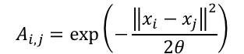
Part 4 – Graph Signal Processing
2
2
1
1
$$A_{i,j}=\exp\left(−\frac{{\left\|x_{i}−x_{j}\right\|}^{2}}{2θ}\right)$$
3
3
5
5
4
4
ASU Plant data (~80 tags)
Sensor network
Part 4

Slide 31
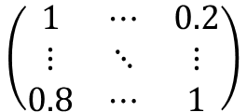
Part 4 – Graph Signal Processing
Sensor network is a combination of a graph and signals residing on the graph
2
2
1
1
$$A_{i,j}=\exp\left(−\frac{{\left\|x_{i}−x_{j}\right\|}^{2}}{2θ}\right)$$
3
3
$$\left(\begin{matrix}1 & ⋯ & 0.2 \\ ⋮ & ⋱ & ⋮ \\ 0.8 & ⋯ & 1\end{matrix}\right)$$
5
5
4
4
ASU Plant data (~80 tags)
Sensor network
Adjacency matrix (A)
Part 4

Slide 32
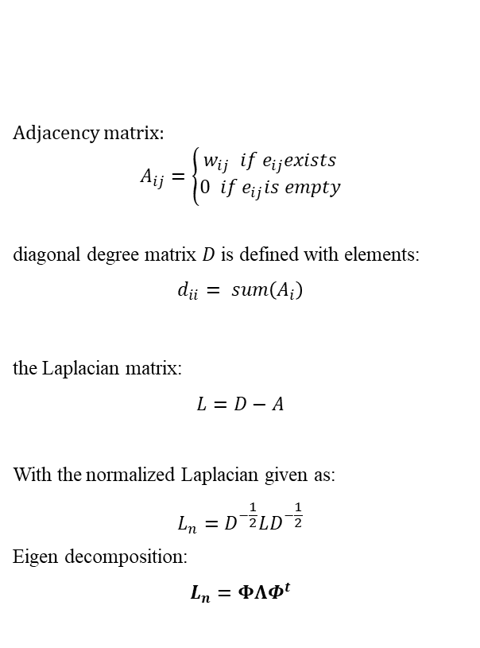
Part 4 – Graph Signal Processing
Adjacency matrix:
$$A_{ij}=\left\{\begin{aligned}w_{ij} if e_{ij}exists \\ 0 if e_{ij}is empty\end{aligned}\right.$$
diagonal degree matrix $D$ is defined with elements:
$$\begin{aligned}d_{ii}= sum\left(A_{i}\right)\#\end{aligned}$$
the Laplacian matrix:
$$\begin{aligned}L=D−A\end{aligned}$$
With the normalized Laplacian given as:
$$\begin{aligned}L_{n}=D^{−\frac{1}{2}}LD^{−\frac{1}{2}}\#\end{aligned}$$
Eigen decomposition:
$$L_{n}=ΦΛΦ^{t}$$
2
1
3
5
4
Part 4

Slide 33
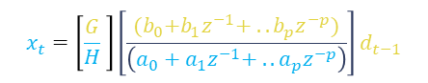
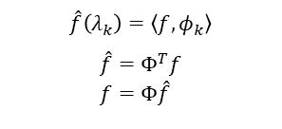
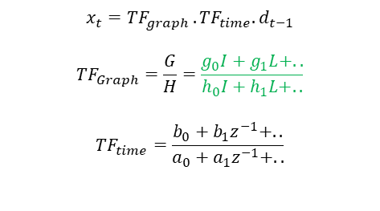
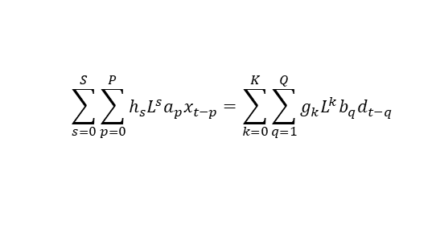

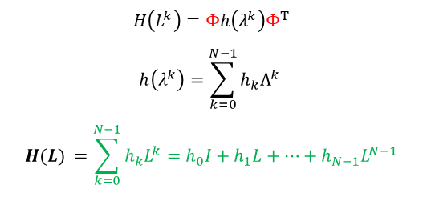
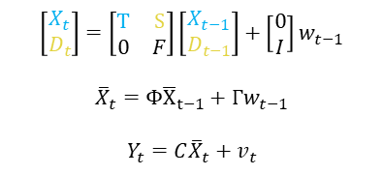
Part 4 – Graph Signal Processing
Graph Fourier Transform
Graph-Time Filters
State-space
$$\begin{aligned}\hat{f}\left(λ_{k}\right)=\left\langle f,φ_{k}\right\rangle \#\end{aligned}$$
$$\hat{f}=Φ^{T}f \\ f=Φ\hat{f}$$
$$\sum_{s=0}^{S}{\sum_{p=0}^{P}{h_{s}L^{s}{a_{p}x}_{t−p}}=\sum_{k=0}^{K}{\sum_{q=1}^{Q}{g_{k}L^{k}{b_{q}d}_{t−q} }}}$$
$$\left[\begin{matrix}X_{t} \\ D_{t}\end{matrix}\right]=\left[\begin{matrix}T & S \\ 0 & F\end{matrix}\right]\left[\begin{matrix}X_{t−1} \\ D_{t−1}\end{matrix}\right]+\left[\begin{matrix}0 \\ I\end{matrix}\right]w_{t−1}$$
$${\overline{X}}_{t}=Φ{\overline{X}}_{t−1}+Γw_{t−1}$$
$$Y_{t}=C{\overline{X}}_{t}+v_{t}$$
$$x_{t}=TF_{graph} . TF_{time}. d_{t−1}$$
$$TF_{Graph}=\frac{G}{H}=\frac{g_{0}I+g_{1}L+..}{h_{0}I+h_{1}L+..}$$
$$TF_{time}=\frac{b_{0}+b_{1}z^{−1}+..}{a_{0}+a_{1}z^{−1}+..}$$
Graph Filters
$$H\left(L^{k}\right)=Φh\left(λ^{k}\right)Φ^{T}$$
$$h\left(λ^{k}\right)=\sum_{k=0}^{N−1}{h_{k}Λ^{k} }$$
$${H(L)}_{ }=\sum_{k=0}^{N−1}{h_{k}L^{k}=h_{0}I+h_{1}L+…+h_{N−1}L_{ }^{N−1}}$$
$$x_{t}=\left[\frac{G}{H} \right]\left[\frac{{(b}_{0}+b_{1}z^{−1}+ ..b_{p}z^{−p})}{\left(a_{0}+a_{1}z^{−1}+ ..a_{p}z^{−p}\right)}\right]d_{t−1}$$
$$x=H\left(L\right)d=Φh\left(λ\right)Φ^{T}d$$
Part 4

Slide 34
Part 4 – Graph Signal Processing
State-space
GSP-MMKF
Sequential Bayesian update
Disturbance model weight update
Trend analysis
Disturbance models
Trend prediction
Plant data
Step
Ramp
Periodic
Part 4

Slide 35
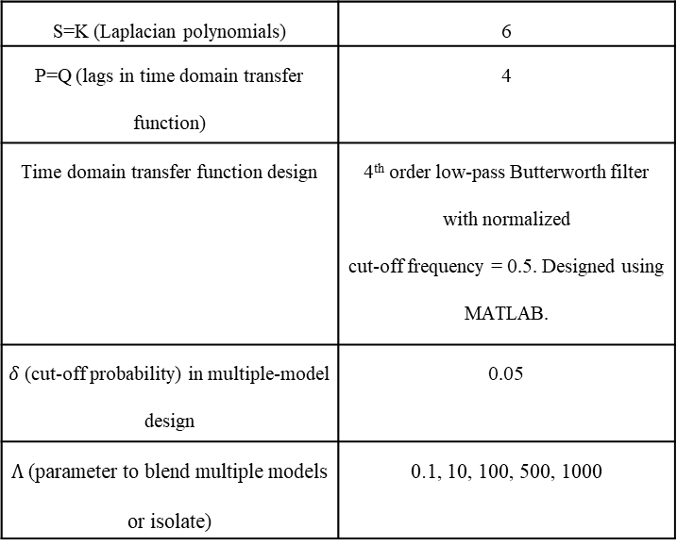
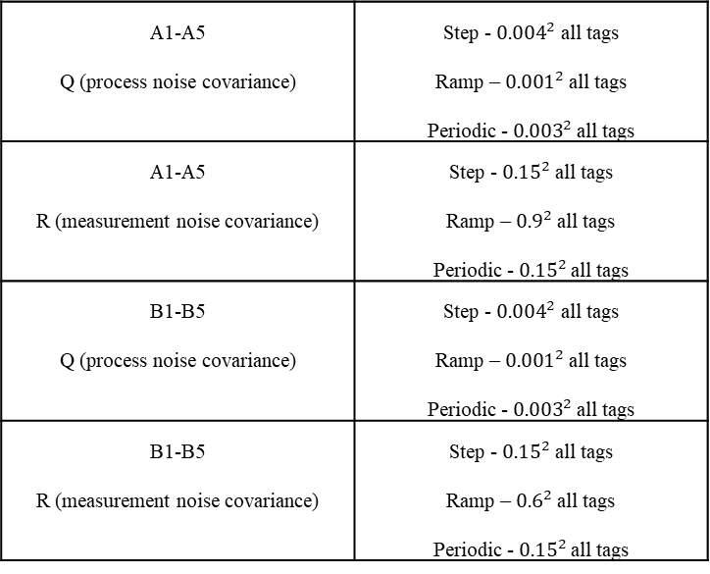
Part 4 – Graph Signal Processing
A1-A5 Q (process noise covariance) | Step - ${0.004}^{2}$ all tags Ramp – ${0.001}^{2}$ all tags Periodic - ${0.003}^{2}$ all tags
A1-A5 R (measurement noise covariance) | Step - ${0.15}^{2}$ all tags Ramp – ${0.9}^{2}$ all tags Periodic - ${0.15}^{2}$ all tags
B1-B5 Q (process noise covariance) | Step - ${0.004}^{2}$ all tags Ramp – ${0.001}^{2}$ all tags Periodic - ${0.003}^{2}$ all tags
B1-B5 R (measurement noise covariance) | Step - ${0.15}^{2}$ all tags Ramp – ${0.6}^{2}$ all tags Periodic - ${0.15}^{2}$ all tags
S=K (Laplacian polynomials) | 6
P=Q (lags in time domain transfer function) | 4
Time domain transfer function design | 4th order low-pass Butterworth filter with normalized cut-off frequency = 0.5. Designed using MATLAB.
$δ$ (cut-off probability) in multiple-model design | 0.05
$Λ$ (parameter to blend multiple models or isolate) | 0.1, 10, 100, 500, 1000
Part 4

Slide 36
Results: Trend analysis (A2 set1)
Fault event ~5170 mins
Part 4

Slide 37
Results: Trend analysis (A5 set1)
Fault event ~5170 mins
Part 4

Slide 38
Results: Trend analysis (A2 set2)
Fault event ~5170 mins
Part 4

Slide 39
Results: Trend analysis (A5 set2)
Fault event ~5170 mins
Part 4

Slide 40
Results: Trend prediction
MSE for A2 (model blending)
MSE for A5 (model selection)
Part 4

Slide 41
Results: Trend prediction (A2)
A2 Tag 13
Model weight jittering between step and periodic
Predictions mismatch with tag data
Model blending not effective
Part 4

Slide 42
Results: Trend prediction (A2)
A2 Tag 56
Correct disturbance model
Predictions follow future trend
Model weight evolves slowly to periodic
Unable to predict small “bump”- possible secondary disturbance
Part 4

Slide 43
Results: Trend prediction (A2)
A2 Tag 34
Blend of step and periodic mostly
Overall prediction is better considering the mild effect of periodic disturbance
Part 4

Slide 44
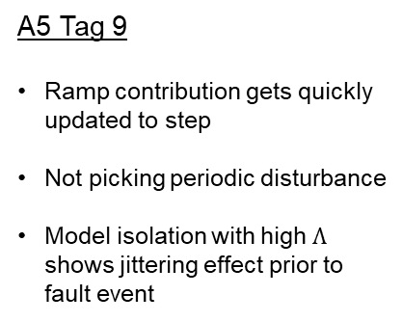
Results: Trend prediction (A5)
A5 Tag 9
Ramp contribution gets quickly updated to step
Not picking periodic disturbance
Model isolation with high $Λ$ shows jittering effect prior to fault event
Part 4

Slide 45
Results: Trend prediction (A5)
A5 Tag 5
Good example of rapid model isolation
Good localized predictions
Not very good overall predictive capability since disturbance model updates are very localized
Part 4

Slide 46
Results: Trend prediction (A5)
A5 Tag 18
Lot of switching between step and periodic
Rapid transition seen
Once again, poor overall predictive capability
Part 4

Slide 47
Summary
Key features for predictive analysis
GSP-MMKF tool development
GSP-MMKF features
Current results on normal plant data
Not able to predict the faults
Part 4

Slide 48


Part 5: Human operator experiment – interface design
Objective:
Understand human factors in process systems from a fundamental aspect
Focus on process startup/shutdown (complex decision making)
Individual versus group tasks
How can these help in better SCR design?
Experiment setup (Dr. Wayne Gray lab @ RPI ):
VAM upstream flowsheet Aspen Dynamics simulation
Controlled variable bounds and low/high alarms →Visual Feedback
Manipulated variables → slider inputs
Person uses a mouse and a monitor
Eye tracking device captures eye-gaze on screen (visual attention)
Part 5

Slide 49
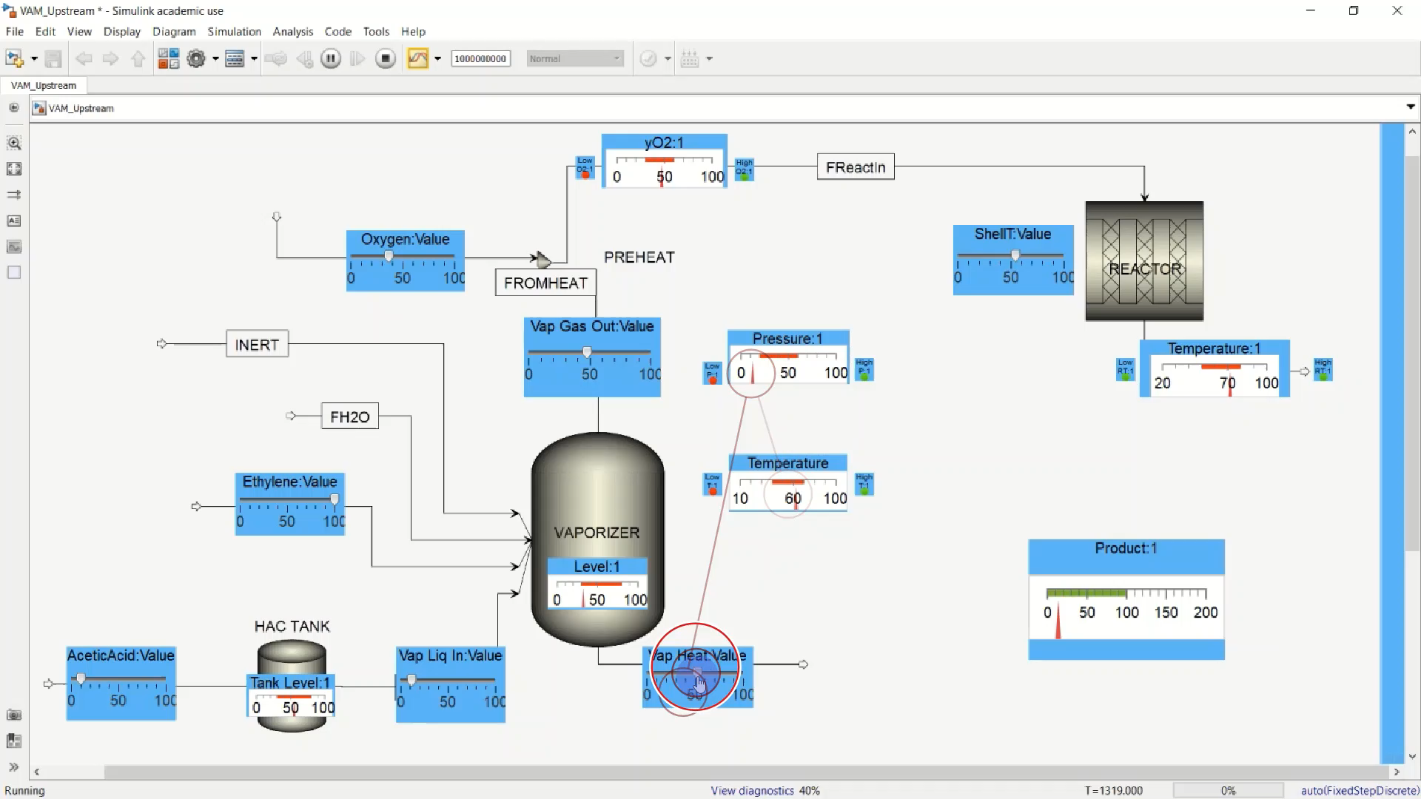
Part 5: Human operator experiment – interface design
Part 5

Slide 50
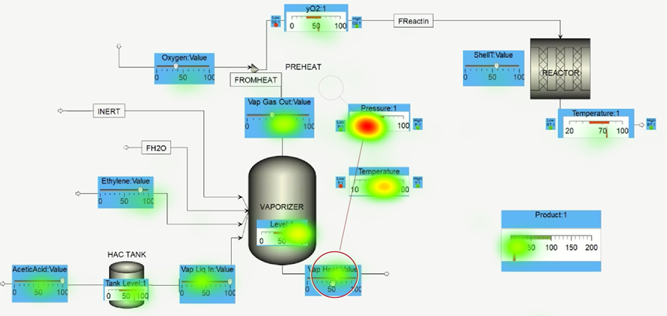
Part 5: Human operator experiment – interface design
Part 5

Slide 51
Overall Summary
VAM simulation
Graph Signal Processing
SCR
Human experiment setup
HiTL MPC

Slide 52
Future work
Reduce plant/model mismatch
Startup/shutdown of Aspen plant using event scripting
MATLAB model completions to get duties for energy driven analysis and other advanced applications (scheduling)
VAM simulation
SCR

Slide 53
Future work
Reduce plant/model mismatch
Startup/shutdown of Aspen plant using event scripting
MATLAB model completions to get duties for energy driven analysis and other advanced applications (scheduling)
VAM simulation
SCR
Tie to experiments, NLP, see how MPC can assist in human decisions during training
Haptic, visual or auditory feedbacks
For a given objective, what kinds of information assist/doesn’t
HiTL MPC

Slide 54
Future work
Reduce plant/model mismatch
Startup/shutdown of Aspen plant using event scripting
MATLAB model completions to get duties for energy driven analysis and other advanced applications (scheduling)
Explore other network building techniques (causality, optimization using Laplacian characteristics)
Add more disturbance banks
Display to operator→ map to flowsheet, use network info (clusters, path etc)
VAM simulation
Graph Signal Processing
SCR
Tie to experiments, NLP, see how MPC can assist in human decisions during training
Haptic, visual or auditory feedbacks
For a given objective, what kinds of information assist/doesn’t
HiTL MPC

Slide 55
Future work
Reduce plant/model mismatch
Startup/shutdown of Aspen plant using event scripting
MATLAB model completions to get duties for energy driven analysis and other advanced applications (scheduling)
Explore other network building techniques (causality, optimization using Laplacian characteristics)
Add more disturbance banks
Display to operator→ map to flowsheet, use network info (clusters, path etc)
VAM simulation
Graph Signal Processing
SCR
Tie to experiments, NLP, see how MPC can assist in human decisions during training
For a given objective, what kinds of information assists/doesn’t
Interface design to adaptively change display of information based on operator’s attention
GSP tool plays a role in network adaptivity of information display
Connecting automation algorithms to kind of feedback desired (haptic, visual, auditory)
Human experiment setup
HiTL MPC

Slide 56
Acknowledgements
Advisor: Dr. B. Wayne Bequette
Committee members: Dr. Joel Plawsky, Dr. Juergen Hahn and Dr. Fotios Kopsaftopoulos
Collaborators: Dr. Wayne Gray and group (Cognitive science & human factors experiments), Entire ASU team
Group members
Current: Dr. Nihat Baysal, Dr. Leander Petersen, Shu Yang, Travis Diamond, Andreas Rebmann, Mrunal Sontakke & Lucky Yerimah
Past: Dr. Pranesh Navarathna, Dr. Daniel Howsmon
All CBE officials and staff
Funding agencies: Howard P. Isermann Fellowship (CBE), RPI Knowledge and Innovation Program (KIP) & Department of Energy (DOE) and Clean Energy Smart Manufacturing Innovation Institute (CESMII)

Slide 57
QUESTIONS?

Slide 58
Publications
Ghosh, S. and Bequette, B.W., 2020. Spectral graph theoretic analysis of process systems: an application to distillation columns. Computers & Chemical Engineering (In revision) Ghosh, S. and Bequette, B.W., 2021. Human-in-The-Loop Model Predictive Control. Manuscript under preparation Ghosh, S., Yang, S. and Bequette, B.W., 2020. Inferential modeling and soft sensors. Smart Manufacturing, pp.323-351. Yang, S., Navarathna, P., Ghosh, S. and Bequette, B.W., 2020. Hybrid Modeling in the Era of Smart Manufacturing. Computers & Chemical Engineering, p.106874.
Ghosh, S. and Bequette, B.W., 2019. Process Systems Engineering and the Human-in-The-Loop: The Smart Control Room. Industrial & Engineering Chemistry Research, 59(6), pp.2422-2429.
Ghosh, S. and Bequette, B.W., 2019. A Framework for the Control Room of the Future: Human-in-the-loop MPC. IFAC-PapersOnLine, 51(34), pp.252-257. Ghosh, S. and Bequette, B.W., 2018. Using Cognitive Computing for the Control Room of the Future. In Computer Aided Chemical Engineering (Vol. 44, pp. 649-654). Elsevier.

Slide 59
Presentations
Ghosh, S and B.W Bequette “Human-in-the-Loop: Coordinated Decision-Making” in AICHE Annual Meeting, 2020, Virtual (https://youtu.be/8NXc-hCLo9c)
Ghosh, S and B.W Bequette “A Framework for the Control Room of the Future: Human-in-the-loop MPC” in 2nd IFAC Conference on Cyber-Physical and Human Systems, Miami, Florida, USA (Dec 2018).
Ghosh, S and B.W Bequette “Using Cognitive Computing for the Control Room of the Future” in Process Systems Engineering, San Diego, California, USA (July 2018).
Ghosh, S, Hahn, J. and B.W Bequette “Fault Detection during Startup/Shutdown of Plants” in New York Automation and Robotics Conference, Troy, NY, USA (October 2017).

Slide 60
REFERENCES
Ghosh, S. and Bequette, B.W., 2020. Human-in-The-Loop Model Predictive Control. Manuscript under preparation.
Ghosh, S. and Bequette, B.W., 2019. Process Systems Engineering and the Human-in-The-Loop: The Smart Control Room. Industrial & Engineering Chemistry Research, 59(6), pp.2422-2429.
Bainbridge, L., 1983. Ironies of automation. In Analysis, design and evaluation of man–machine systems (pp. 129-135). Pergamon.
Rasmussen, J., 1983. Skills, rules and knowledge ; Signals, signs and symbols and other distinctions in human performance models. IEEE Trans. Syst. Man. Cybern. 13, 257–266.
Storms, J.G., Tilbury, D.M., 2014. Blending of human and obstacle avoidance control for a high speed mobile robot. Proc. Am. Control Conf. 3488–3493. https://doi.org/10.1109/ACC.2014.6859352
Chipalkatty, R., Daepp, H., Egerstedt, M., Book, W., 2011. Human-in-the-loop: MPC for shared control of a quadruped rescue robot. 2011 IEEE/RSJ Int. Conf. Intell. Robot. Syst. 4556–4561. https://doi.org/10.1109/iros.2011.6094601
Isufi, E., Loukas, A., Simonetto, A., Leus, G., 2016. Separable autoregressive moving average graph-temporal filters. Eur. Signal Process. Conf. 2016-Novem, 200–204. https://doi.org/10.1109/EUSIPCO.2016.7760238
Luyben, M.L., Tyréus, B.D., 1998. An industrial design/control study for the vinyl acetate monomer process. Comput. Chem. Eng. 22, 867–877. https://doi.org/10.1016/S0098-1354(98)00030-1

Slide 61
REFERENCES
Shuman, D.I., Narang, S.K., Frossard, P., Ortega, A., Vandergheynst, P., 2013. The emerging field of signal processing on graphs. IEEE Signal Process. Mag. 30, 83–98. https://doi.org/10.1109/MSP.2012.2235192

